Slide 1


Quantum Computing
Done By,
Mohammad Makki

Slide 2


Outline
Introduction
Quantum Shannon theory
Shannon’s theorem
Turing machine
Computational complexity
Quantum physics concepts
Data representation on a quantum computer
Quantum cryptography

Slide 3
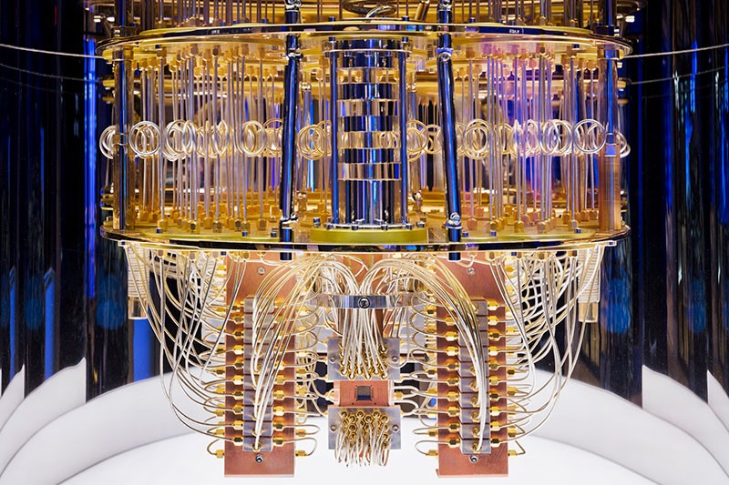
Introduction
Quantum computing is a type of computation that harnesses the collective properties of quantum states to perform calculations.
The devices that perform quantum computations are known as quantum computers.
Retrieved from Quantum computing: the hype and hopes
https://new.abb.com/news/detail/74736/quantum-computing-the-hype-and-hopes

Slide 4
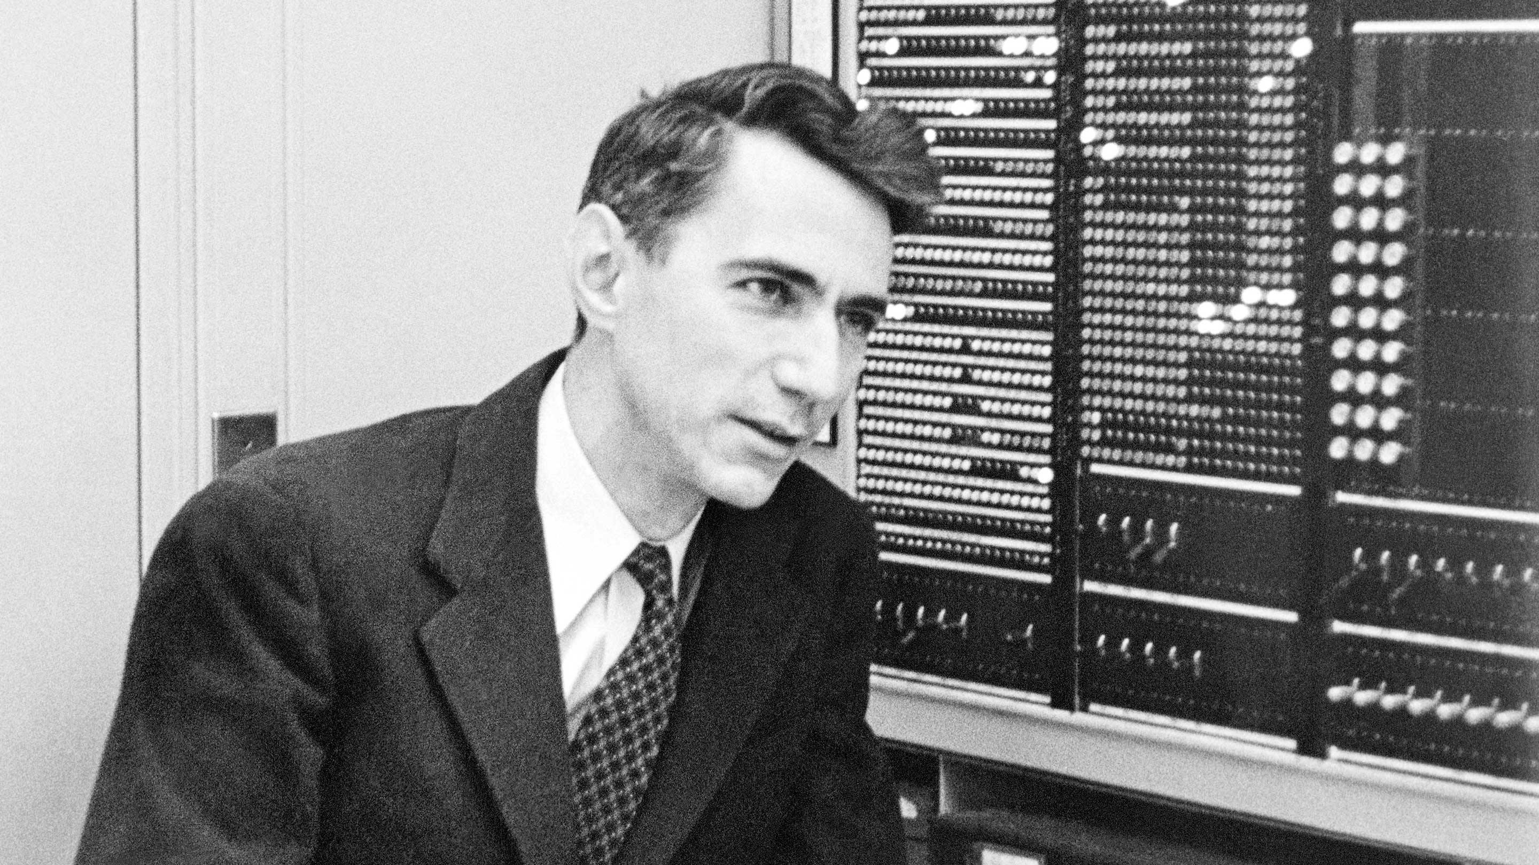
Quantum Shannon theory
Named after Claude Shannon, Quantum Shannon theory involves the study of the upmost capability of noisy physical systems that are governed by the laws of quantum mechanics, to preserve information and correlations.
Retrieved from How Claude Shannon Invented the Future | Quanta Magazine
https://www.quantamagazine.org/how-claude-shannons-information-theory-invented-the-future-20201222/

Slide 5
Shannon’s theorem
In information theory, Shannon's theorem establishes an upper bound to the capacity of a link, in bits per second (bps), as a function of the available bandwidth and the signal-to-noise ratio of the link.
Its formula is as follows:
C = B * log2(1+ S/N)

Slide 6
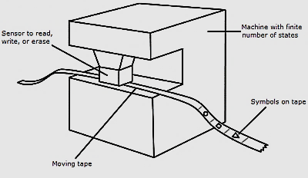
Turing machine
A Turing machine is an abstract mathematical model for all machines, like state machines or automata.
It is made up of three main parts:
Tape
Head
State register
Retrieved from Runestone Academy Turing Machines https://runestone.academy/runestone/books/published/TeacherCSP/CSPTuring/turingMachines.html

Slide 7

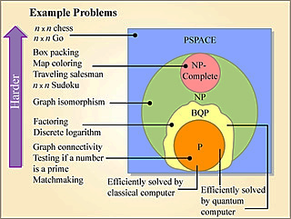
Computational complexity
Computational complexity theory is the classification of computational problems according to their inherent difficulty and relating those classes to each other.
Retrieved from Massachusetts Institute of Technology Quantum Complexity Theory
https://ocw.mit.edu/courses/electrical-engineering-and-computer-science/6-845-quantum-complexity-theory-fall-2010/

Slide 8
Quantum physics concepts
Indeterminism
Interference
Uncertainty
Superposition
Entanglement
Fundamental concepts of the
quantum theory include:

Slide 9
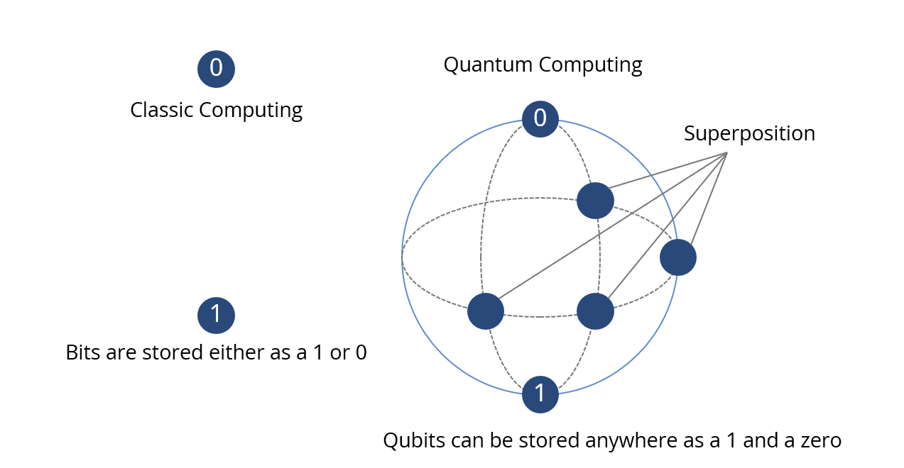
Data representation on a quantum computer
Unlike classical computers, quantum computers are based on the unique principles of quantum mechanics.
Quantum computers use qubits which are typically subatomic particles such as electrons or photons.
Retrieved from Quantum Computing and The Future of Big Data
https://bigdatapath.wordpress.com/2021/01/13/quantum-computing-and-the-future-of-big-data/

Slide 10
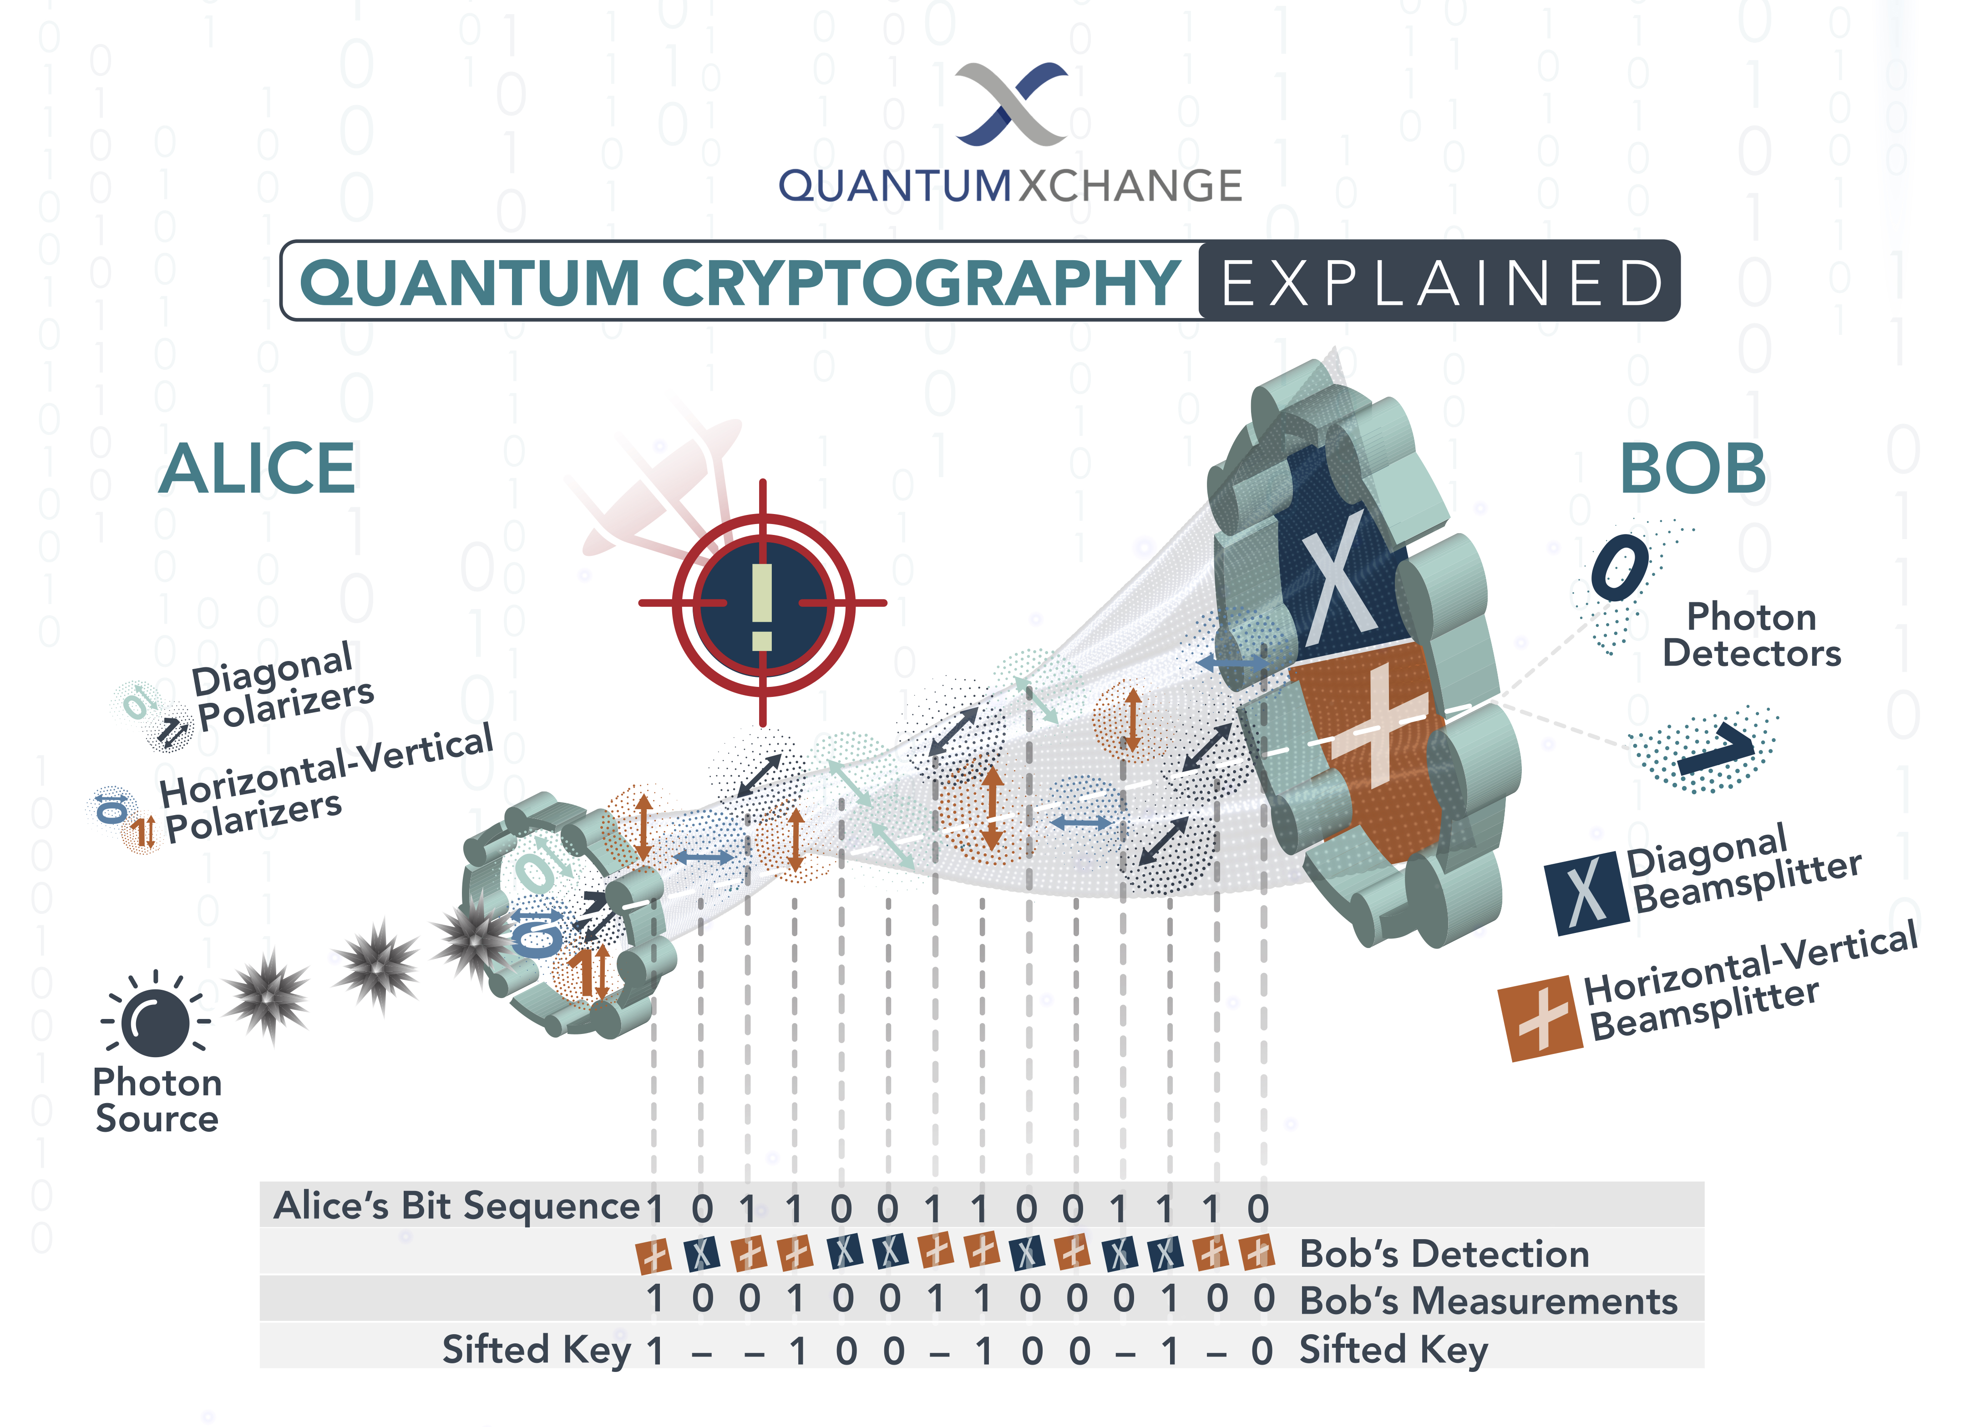
Quantum Cryptography
Retrieved from Quantum Cryptography Explained
https://quantumxc.com/blog/quantum-cryptography-explained/

Slide 11
References
Davie, L L Peterson and B S. 1996. "Computer Networks:a systems approach (Morgan Kaufmann)." 94-95.
Boyd, John. 2020. Novel Error Correction Code Opens a New Approach to Universal Quantum Computing. June 3. Accessed 11 26, 2021. https://spectrum.ieee.org/novel-error-correction-code-opens-a-new-approach-to-universal-quantum-computing.
Benčević, Marin. 2019. What’s a Turing Machine? (And Why Does It Matter?). April 1. Accessed 11 25, 2021. https://medium.com/background-thread/whats-a-turing-machine-and-why-does-it-matter-1cd1b4606c6a.
Wilde, Mark M. 2019. From Classical to Quantum Shannon. Baton Rouge, Louisiana 70803, USA: Hearne Institute for Theoretical Physics.
Scott Aaronson. 6.845 Quantum Complexity Theory. Fall 2010. Massachusetts Institute of Technology: MIT OpenCourseWare, https://ocw.mit.edu. License: Creative Commons BY-NC-SA.
M. Hirvensalo, Quantum computing: With 5 figures. Berlin etc.!: Springer, 2001.
J. Preskill, “Quantum Computing in the NISQ era and beyond,” The open journal for quantum science, vol. 2, pp. 79–79, Aug. 2018.
R. Steane, IOP Publishing Ltd, rep., 1998.
R. Horodecki, P. Horodecki, M. Horodecki, and K. Horodecki, “Quantum entanglement,” Reviews of Modern Physics, vol. 81, no. 2, pp. 865–942, 2009.
C. P. Williams, Explorations in quantum computing. Springer London, 2011.
S.-S. Li, G.-L. Long, F.-S. Bai, S.-L. Feng, and H.-Z. Zheng, “Quantum computing,” PNAS, 09-Oct-2001. [Online]. Available: https://www.pnas.org/content/98/21/11847.short. [Accessed: 12-Sep-2021].
T. Hey, “Quantum (Davie 1996) computing: an introduction,” Computing & Control Engineering Journal, vol. 10, no. 3, pp. 105–112, 1999.

Slide 12
Thank you

